Slide 1
Case study on rural Electrification Program using Solar Energy
bgbfrdvswve

Slide 2
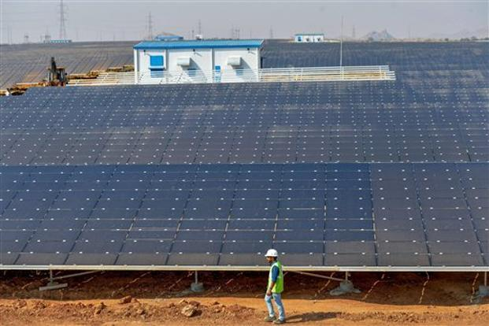
World’s Largest Solar Power Plant Launched in Karnataka
Shakti Sthala
2,000 MW
Rs16,500 crore
Pavagada in Karnataka’s Tumakuru district
By 2020

Slide 3
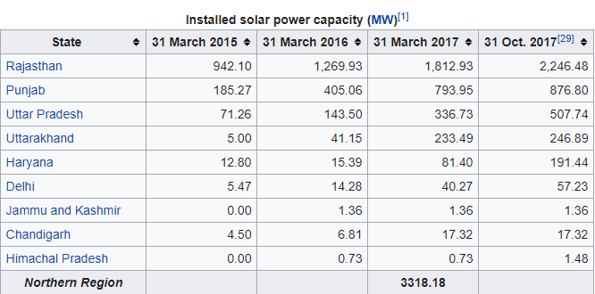
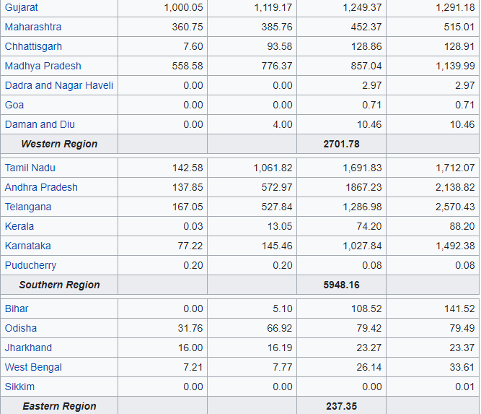

Slide 4
